Slide 1
Sustainable Maryland Leadership Training: Equitable Engagement in Local Government
March 16, 2021
Virtual Program

Slide 2
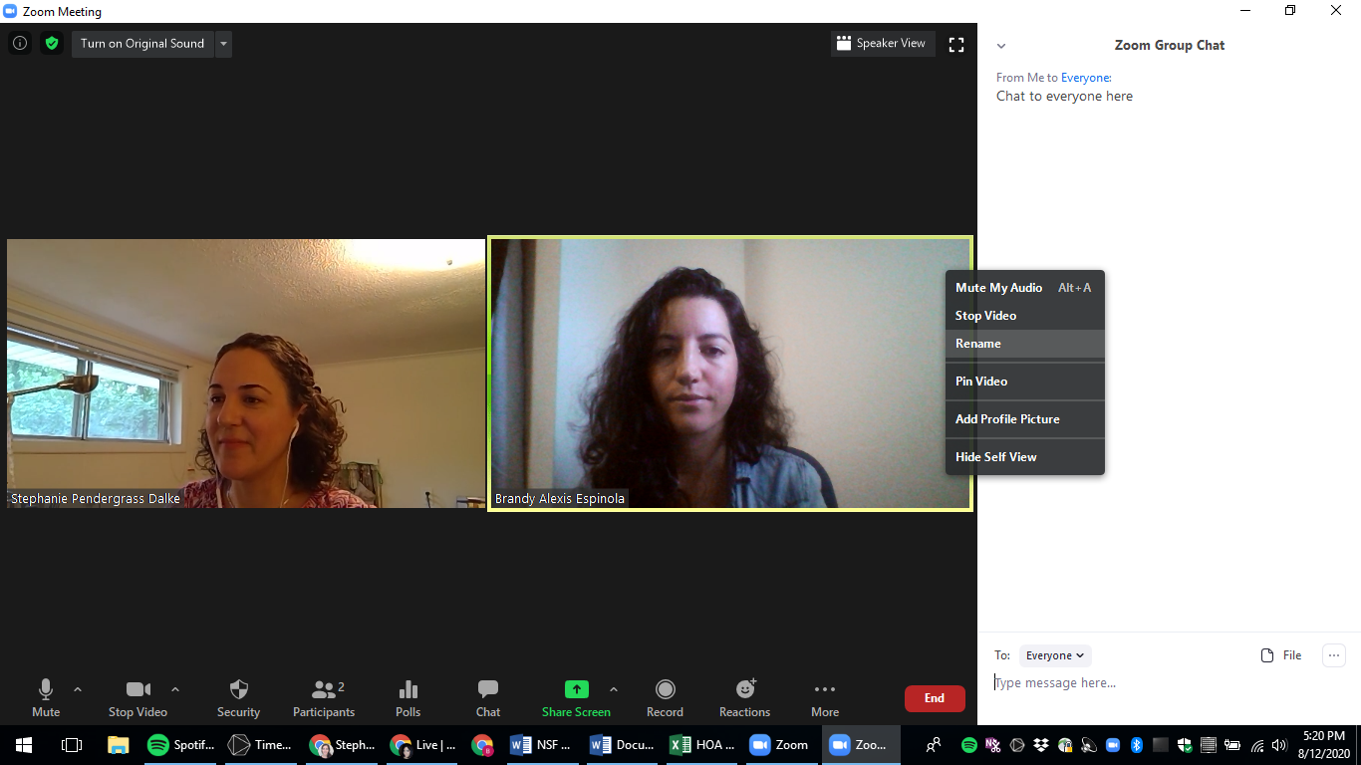
ZOOM “CHEAT SHEET”
Switch between “Gallery” and “Speaker View”
Hover over and then left click on three dots … at the top right of your video. Rename your image.
…
“Chat” window for questions and saying hello
Mute and Unmute here
Start and Stop video here
Chat with “Everyone” or with specific people
Open “Participants” or “Chat” window
Notes:
Please Get rid of distractions and try and be present for the duration of the training.
Remember to keep yourself muted during presentations.
Feel free to use the chat to ask questions at any time, we will try and make sure these questions are answered at the appropriate time.
Change your virtual name tags so folks know who you are, and where you are from. If you haven’t done this before you can do this by
Rick Clicking On Your Video Image , hover over three dots at the top right of your video, click on rename, change your name to
First Name, Name of the community or organization you represent

Slide 3
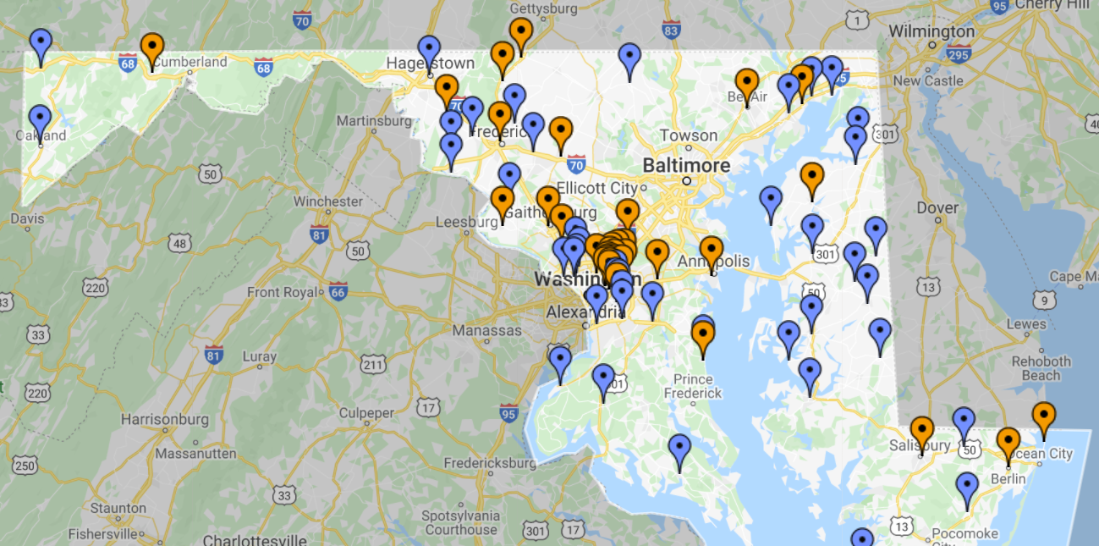
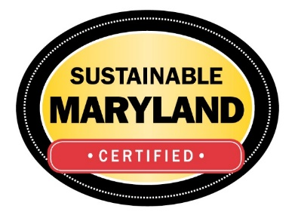
Welcome & Introductions
Sustainable Maryland
A Free and Voluntary program for communities that want to go green and save green
We help communities:
Choose a direction for their sustainability efforts
Improve access to resources
Share successes with other communities
Certify Municipal progress
Notes:
Quick Intro to Sustainable Maryland for those who are not familiar with the program -
Sustainable Maryland offers a menu of actions, allowing communities to choose activities specific to their needs and plan across community priorities to achieve multiple community benefits. The program provides a framework to benchmark sustainability initiatives and facilitates community prioritization.
We currently have 36 municipalities certified and 79 registered in the program all of which have residential Green Teams, engaged Municipal Staff, and supportive elected officials working together to make their communities more sustainable. While we are all working to protect our environment and improve the quality of life for all our residents, it is important to acknowledge the original stewards of this state we now call home.

Slide 4
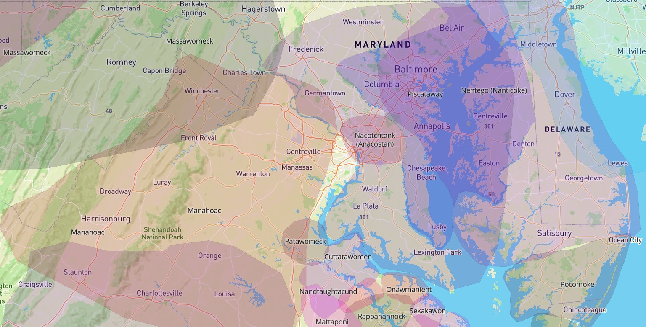
Maryland Native Land
https://native-land.ca/
Notes:
Right now we’d like to do a land acknowledgement.
"At the University of MD, we believe it is important to create dialogue to honor those that have been historically and systemically disenfranchised. So, we acknowledge the truth that is often buried: At the University of Maryland, we are on the ancestral lands of the Piscataway People, who were among the first in the Western Hemisphere. We are on indigenous land that was stolen from the Piscataway People by European colonists. We pay respects to Piscataway elders and ancestors. Across the state, we honor the original custodians of this land, including the Accomack, and Pocomoke on the Eastern Shore all the way to the Massawomeck in Western Maryland. Please take a moment to consider the many legacies of violence, displacement, migration, and settlement that bring us together here today.“
[MIKE TAKE 10 – 15 second pause]
Thank you. We also invite people to identify the original custodians of your land and offer acknowledgement in chat https://native-land.ca/ (Alexis to drop in the chat)

Slide 5
Introductions
Who is in the Zoom room today?
How many total hours of training on racial, economic, and gender identity have you ever attended?
How would you describe your understanding of racial, economic, and gender equity?
Can you confidently articulate the definition and importance of equity to your peers?
What best describes your race/ethnicity?
Notes:
Before we jump into today’s agenda it would be great to get a sense for who all is in the room today. We will use a zoom poll to ask a few ice breaker questions.
1. Who is in the Zoom room today? [check all that apply]
Municipal staff
Municipal elected official
Municipal Green Team
County staff
County elected official
State agency
Nonprofit
Local Business
HOA/Civic Association
Engaged Citizen
Other
2. How many total hours of training on racial, economic, and gender identity have you ever attended?.
None
1 – 3 hours
4 – 5 hours
6 – 8 hours
2- 4 days
5-7 days
Multiple weeks
3. How would you describe your understanding of racial, economic, and gender equity?
Little or no understanding
Beginner
Intermediate
Advanced
Expert
4. I can confidently articulate the definition and importance of equity to my peers.
Strongly agree
Somewhat agree
Neutral/Unsure
Somewhat disagree
Strongly disagree
5. Has your community started talking about diversity, equity, inclusion and justice? How would you describe these efforts to date? [this can be a chat or breakout question]
6. Which best describes your race/ethnicity? [if you want to ask this]
White/European
Black/African American
Latino/a/x
Middle Eastern
Asian (including Southern & Southeast Asian)
Native American/Native Alaskan
Native Hawaiian/ Pacific Islander
Multi-racial (with white/European mixed ancestry)
Multi-racial (person of color)
Other

Slide 6
Agenda
Welcome & Introductions
1:20-2:20
Presentation: Introduction to JEDI
2:20-3:00
Breakout Discussions
Panel: Local Examples of Equitable Engagement
4:45-5:00
3:15-4:45
Thank You & Close
BREAK
1:00-1:20
3:00-3:15

Slide 7
Event Outcomes
Become familiar with the concepts and practices of diversity, equity, inclusion, and justice
Ground your work in real world equity issues and how they impact communities
Hear about practical strategies local governments are adopting to increase equity in their outreach and community engagement efforts
Share and deepen connections with other Sustainable Maryland communities

Slide 8
Enjoy Your Break! See you back at 3:15 PM
It’s Sustainable Maryland’s 10th Anniversary!!!
SM Wednesday Webinar Series
Coming in May
New SM Website and New Actions
SM Earth Day Challenge
Join us as we celebrate throughout the year
March – June every Wednesday @ 2:00PM
Register your April Earth Day events to get recognized by Sustainable Maryland
Sustainable Maryland
Program News and Upcoming Events
Notes:
Spring Website updates
New Actions + New certification tier
10th Anniversary
http://bit.ly/38IOGTb

Slide 9
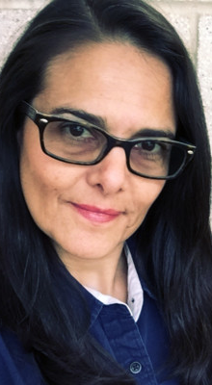
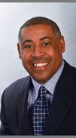
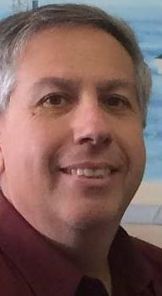
Local Examples of Equitable Engagement
Moderator:
Dr. Luisa Robles, Sustainability Coordinator, City of Greenbelt
Panelists:
Dr. Derek Shackelford, Alderman, City of Frederick
Kate Stewart, Mayor, City of Takoma Park
Larry DiRe, Town Manager, Town of Federalsburg
Notes:
Welcome Back – two sentences on what the panel is about
Introduce the Moderator
Dr. Luisa Robles, Sustainability Specialist, City of Greenbelt
● Luisa F. Robles studied general biology in Mexico, and has a PhD from UMD on Sustainable Development/Ecological Economics. She now works as the Sustainability Coordinator for the City of Greenbelt. Luisa has been a huge champion of the Sustainable Maryland program and has attended every Leadership Training since we started them back in 2014.

Slide 10
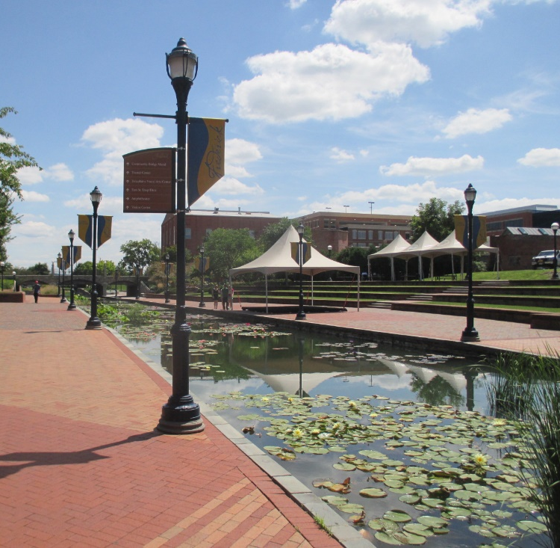
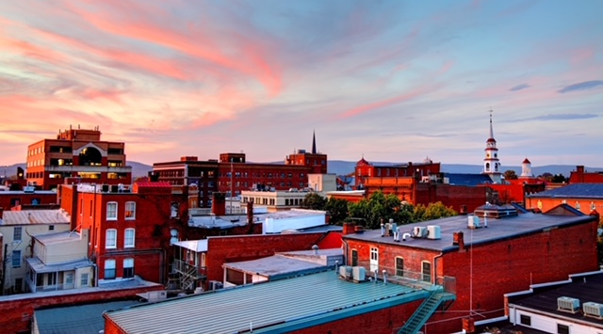
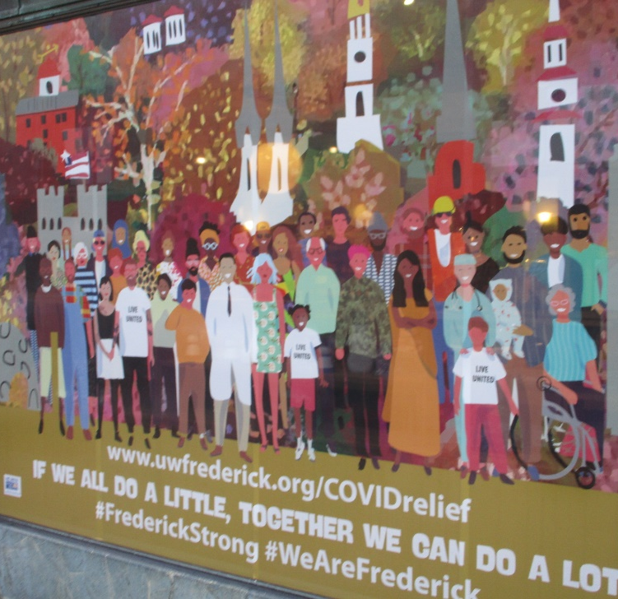
City of Frederick

Slide 11
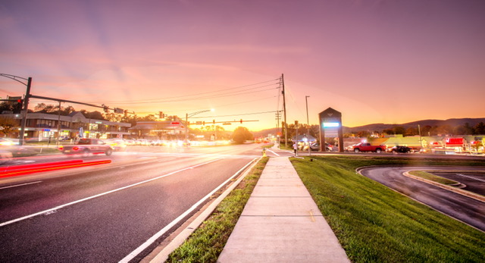
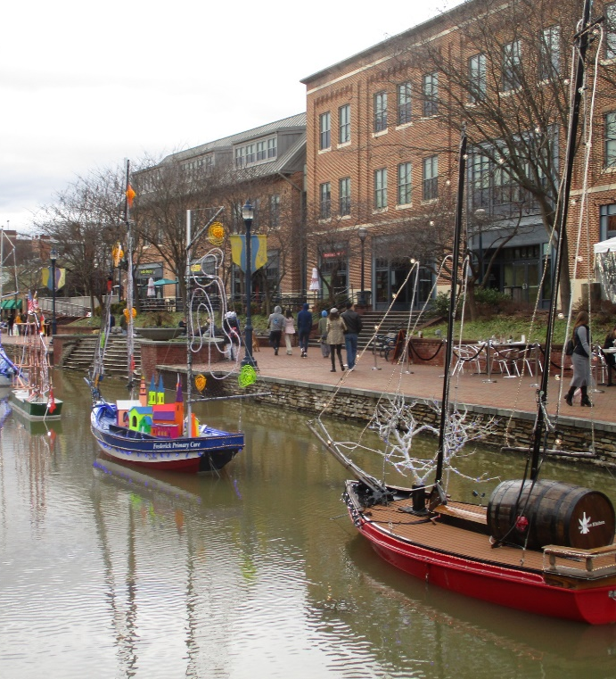
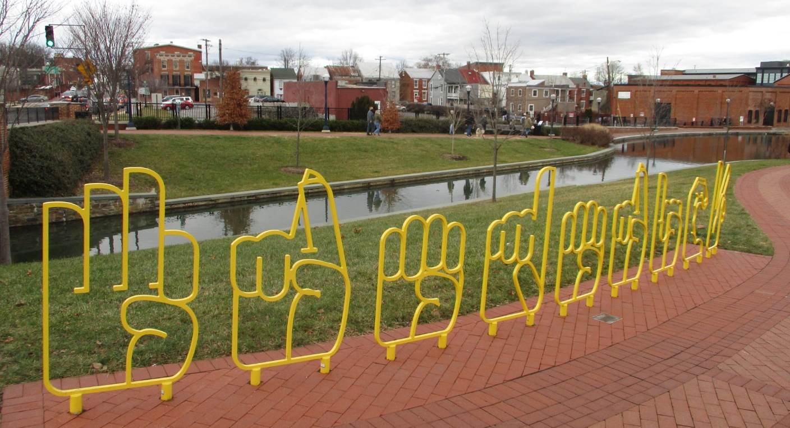
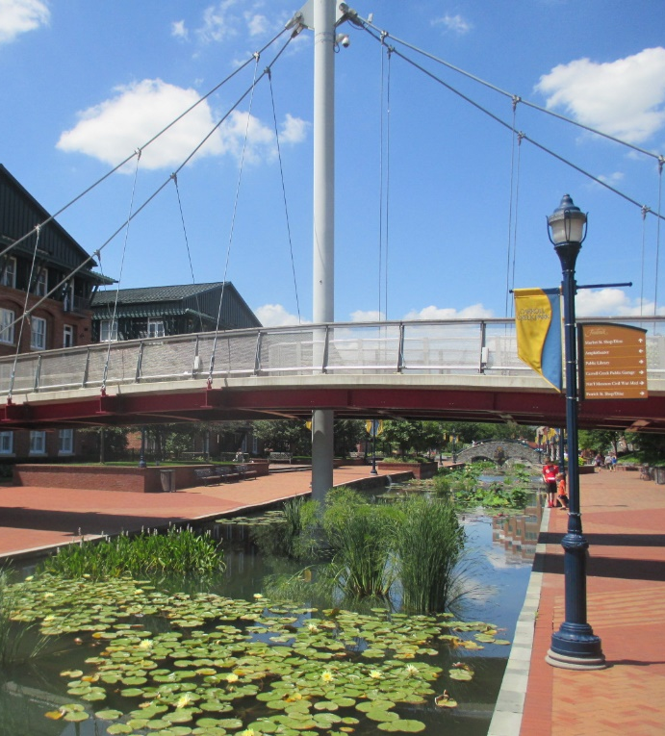

Slide 12
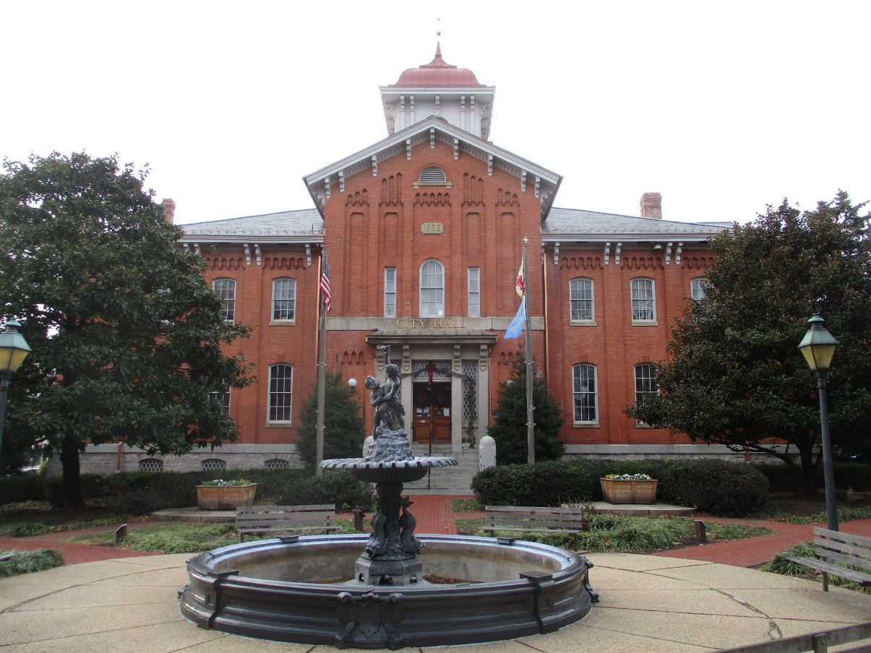
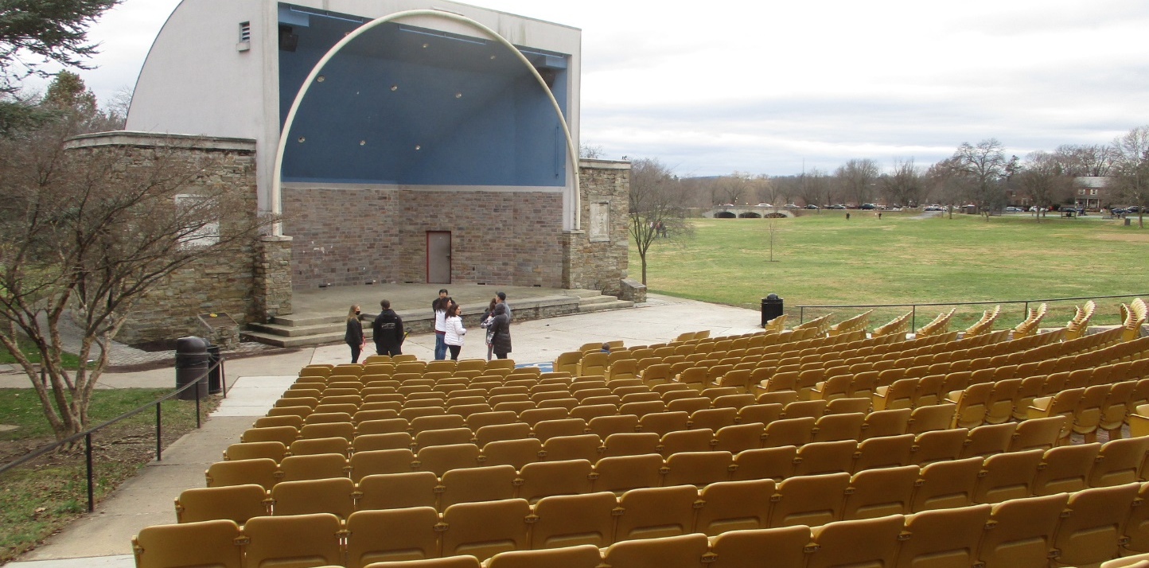

Slide 13
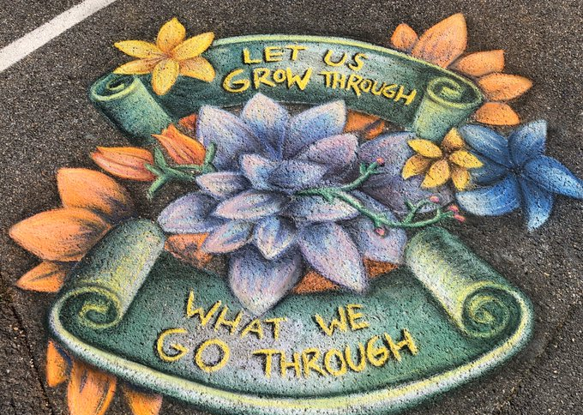
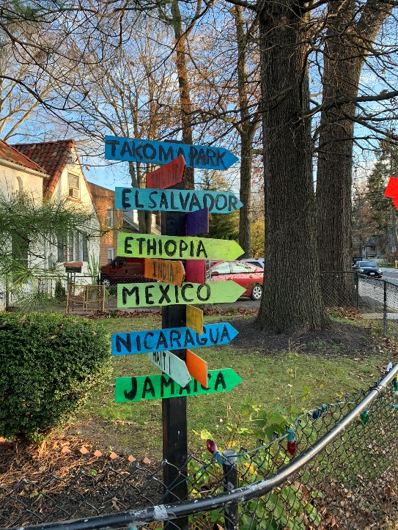
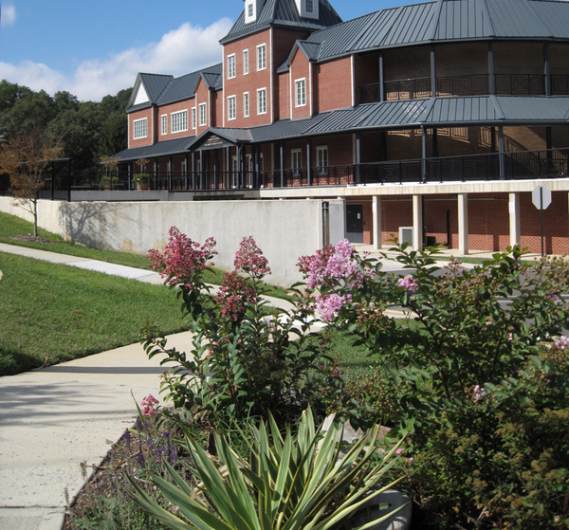
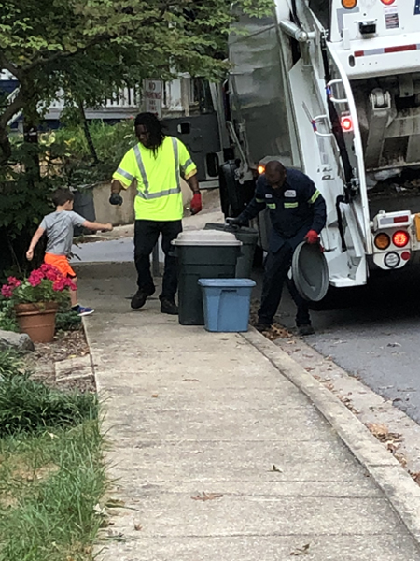
City of Takoma Park

Slide 14
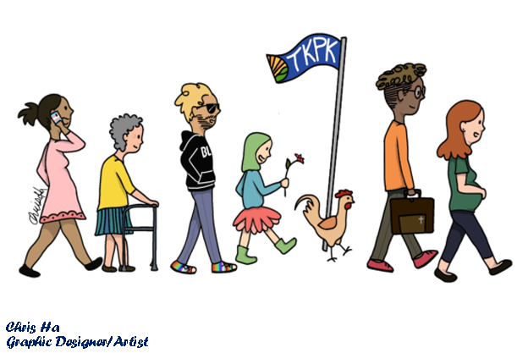
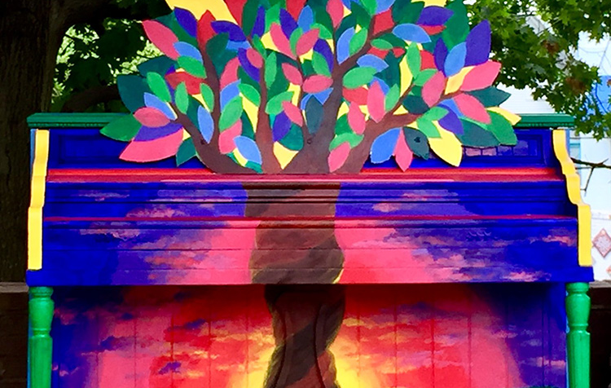
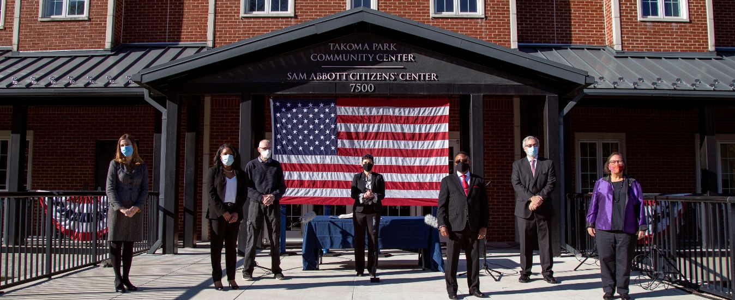

Slide 15
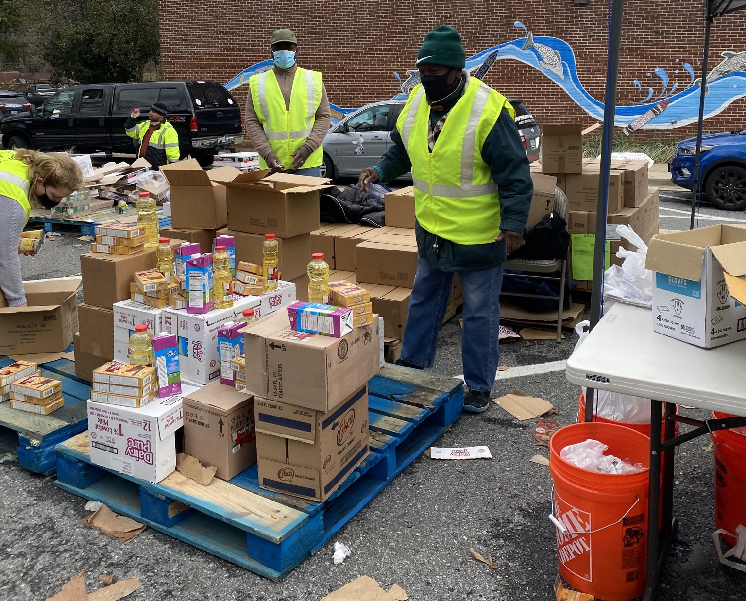
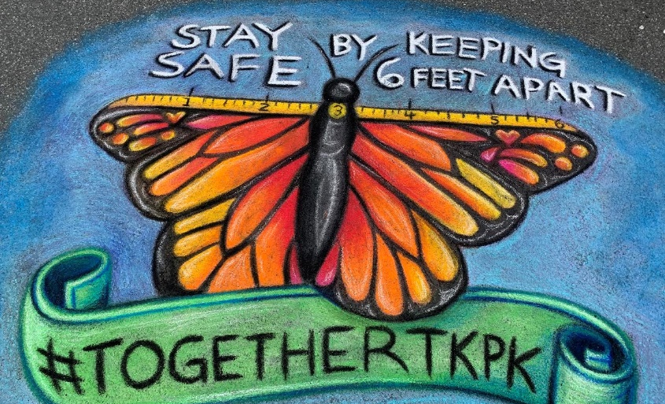
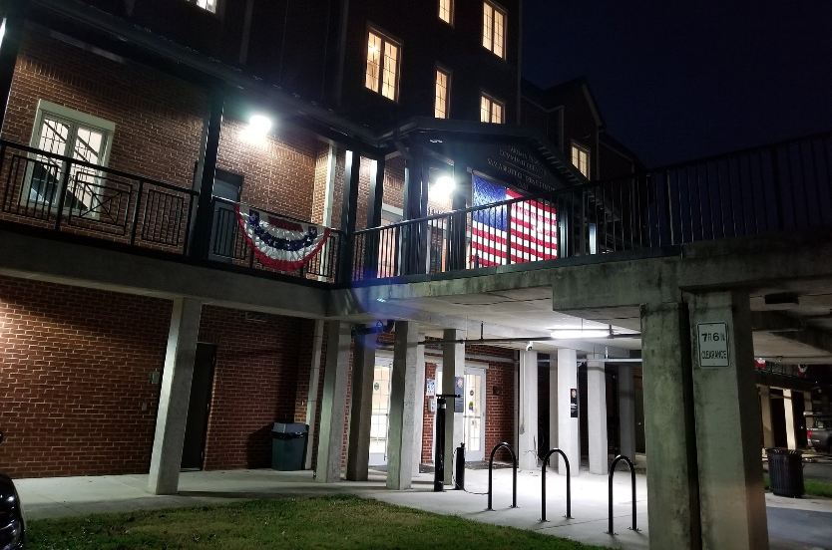
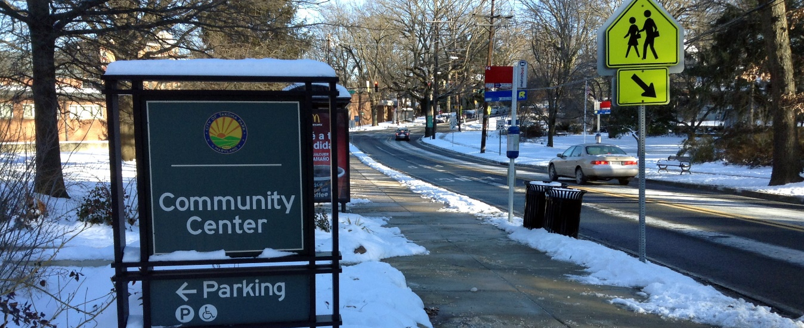

Slide 16
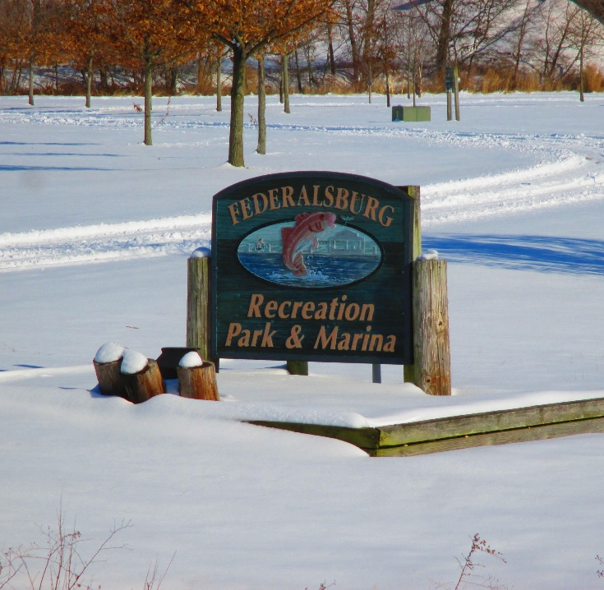
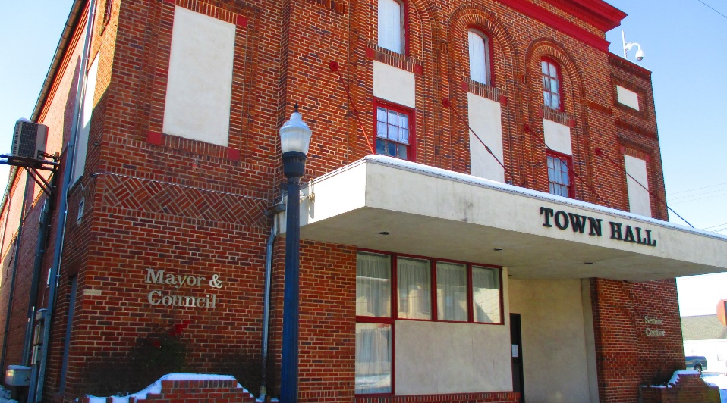
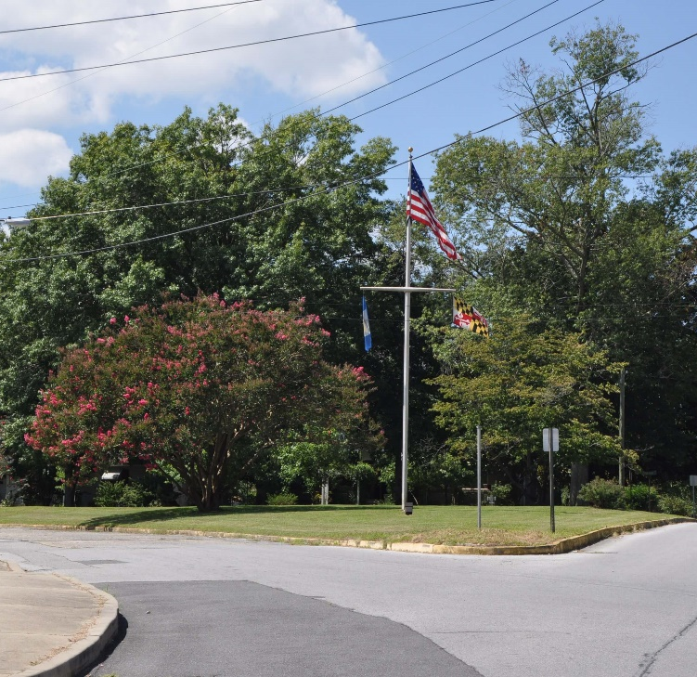
Town of Federalsburg

Slide 17
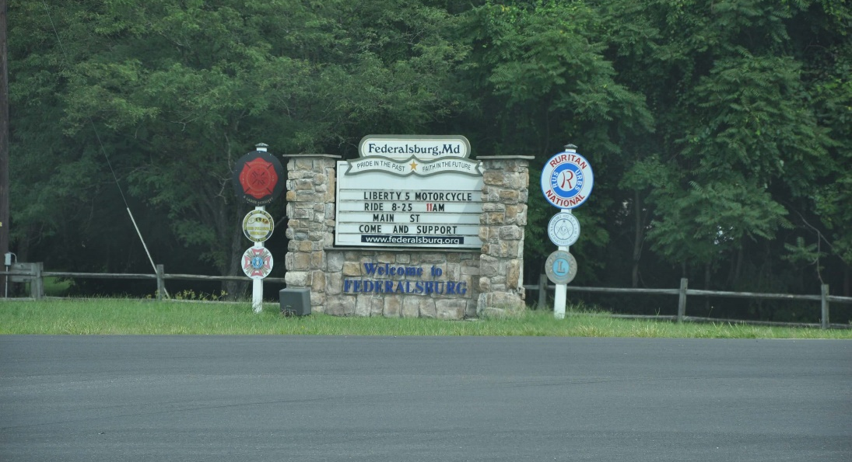
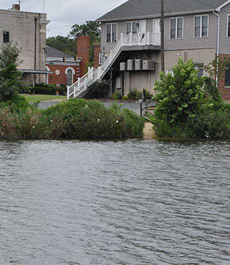
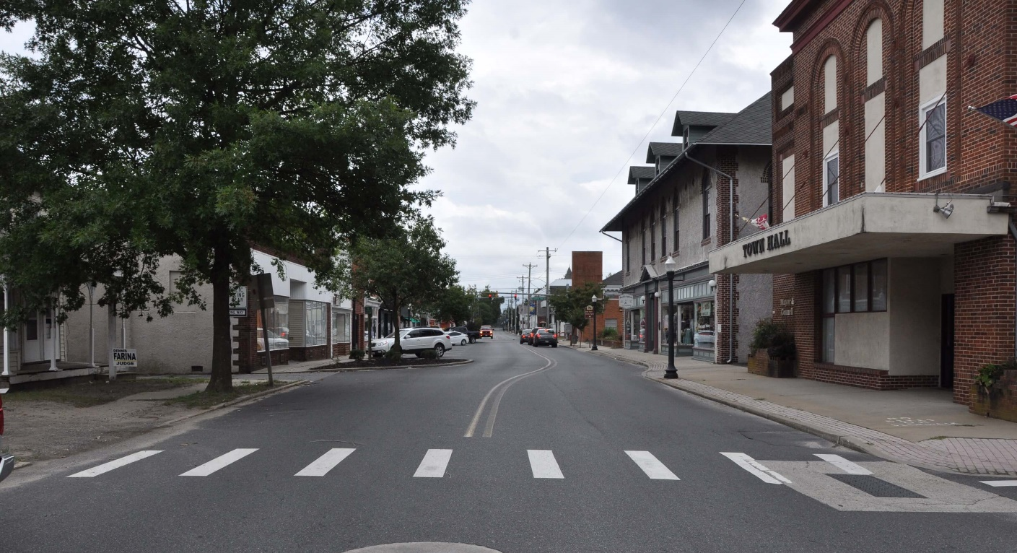
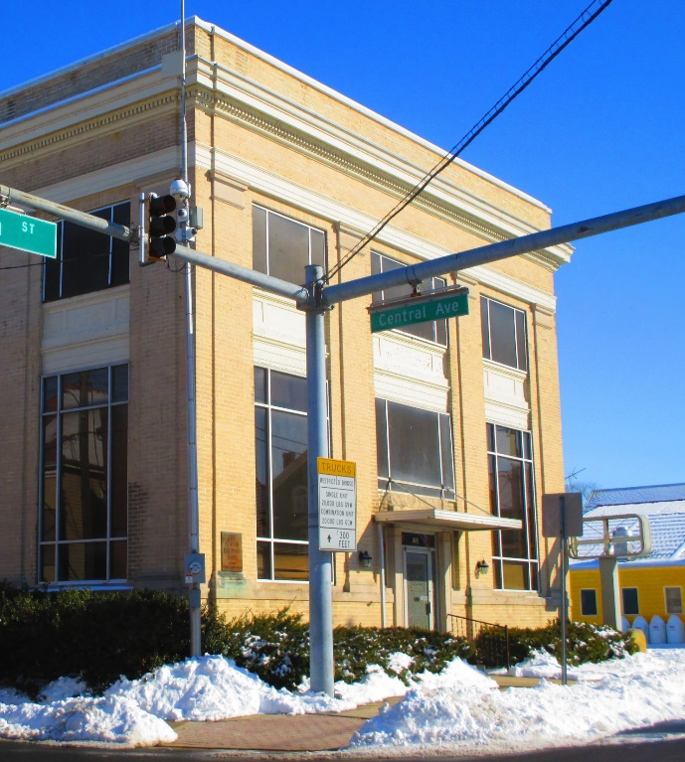

Slide 18
Sustainable Maryland Next Steps
Slides and resources from today’s presentation will be shared in the coming days
SM will continue to work with the Sustainable States Network Equity Cohort to learn from our programmatic peers and grow our own equity efforts
Please fill out the electronic survey to let us know how we did and what other resources and assistance you may need to advance your local equity efforts
Notes:
Thank you to attendees and speakers
Slides for today will be shared
SSN Cohort work, beginning more to come
Program Reminders & Resources

Slide 19
Sustainable Maryland Program Reminders
It’s Sustainable Maryland’s 10th Anniversary!!!
SM Wednesday Webinar Series
Coming in May
New SM Website and New Actions
SM Earth Day Challenge
Join us as we celebrate throughout the year
March – June every Wednesday @ 2:00PM
Register your April Earth Day events to get recognized by Sustainable Maryland
Notes:
Spring Website updates
New Actions + New certification tier
10th Anniversary
http://bit.ly/38IOGTb

Slide 20
Other Upcoming Events
Prince George’s County Sustainability Summit for HOAs
March 30th @ 6:30PM
City of Gaithersburg Sustainability Summit for HOAs
April 13th @ 6:30PM
Prince George’s County Climate Action Plan
Virtual Open House

Slide 21
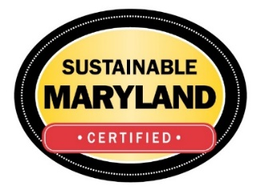
Thank You!
Mike Hunninghake
Program Manager
301-405-7956
mikeh75@umd.edu

